Slide 1




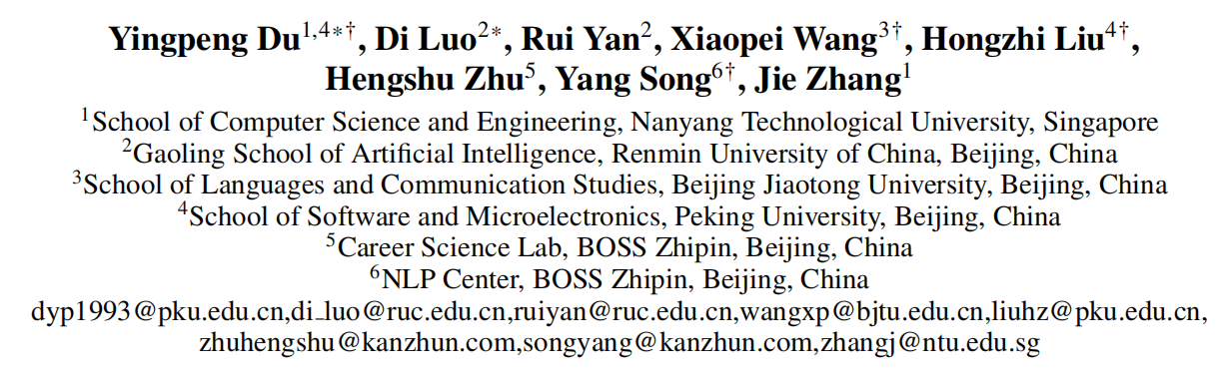





ATAI
Advanced Techniqueof Artificial Intelligence
ATAI
ChongqingUniversity _{AdvancedTechniqueof}
of Technology Artificial Intelligence
Chongqing University of
Technology
Chongqing University ^{ATAI}
_{of Technology} Advanced Techniqueof
Artificial Intelligence
Chongqing University of Technology
Chongqing University of Technology
Enhancing Job Recommendation through
LLM-Based Generative Adversarial Networks
—— AAAI 2024
Code:None
Reported by Jing Li
1

Slide 2

ATAI
AdvancedTechniqueof
Artificial Intelligence
ATAI
ChongqingUniversity _{AdvancedTechniqueof}
of Technology Artificial Intelligence
ChongqingUniversity of Technology
Motivation
(1) Simply leveraging LLMs to enhance user resumes is not a onesize-fits-all solution for job recommendation. Due to the widespread fabrications and hallucinations within LLMs, it is difficult to generate high-quality resumes without users’ reliable interactive information.
(2) Nevertheless, some users still suffer from the few-shot problem, which arises due to scarce interaction records, leading to limited guidance for high-quality resume generation
Notes:
在多模态学习场景中，某些模态比其他模态更占主导地位，因此模型将优化这些主导模态，并倾向于忽略其他模态，从而导致次优性能信息量较少的模态的优化不足，从而导致次优融合性能，因此出现了被称为模态惰性的现象。
多模态数据经常不相互纠缠或数据规模不同，导致整合困难。现实中采集的数据可能存在关键模态缺失的问题。
目前很多方法用的都是对所有模态进行联合优化（同时对所有模态的数据进行训练，使用一个整体的损失函数来联合优化各个模态的参数）
导致模态间干扰，产生模态惰性问题。
同时处理多模态数据，计算和存储需求较高，对数据的要求高。

Slide 3

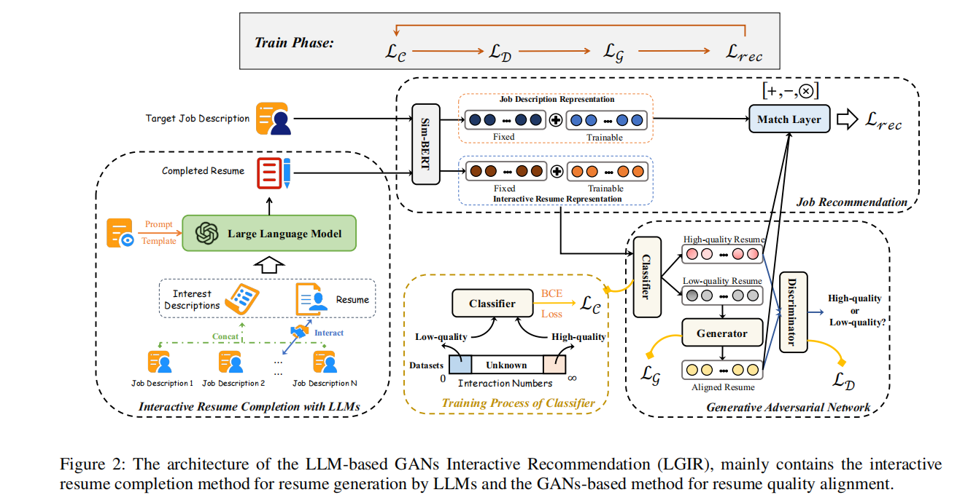
ChongqingUniversity of Technology
ATAI
AdvancedTechniqueof
Artificial Intelligence
ATAI
ChongqingUniversity _{AdvancedTechniqueof}
of Technology Artificial Intelligence
Overview
Notes:
实现交替单模态学习，每个时间步t确定当前输入的模态mt，确保每个模态都能独立进行优化，避免模态惰性问题。
计算对应模态的数据损失
使用梯度下降更新模态特定的参数
计算梯度修改矩阵
更新共享参数
计算每个模态的预测不确定性
确定模态重要性系数
组合所有模态的预测得到预测值

Slide 4

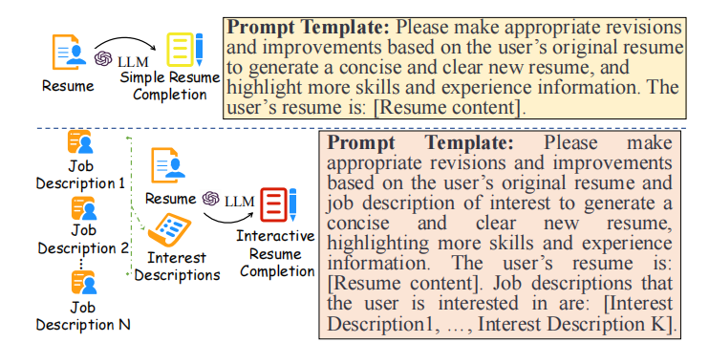

ChongqingUniversity of Technology
ATAI
AdvancedTechniqueof
Artificial Intelligence
ATAI
ChongqingUniversity _{AdvancedTechniqueof}
of Technology Artificial Intelligence
Method

Slide 5

ChongqingUniversity of Technology
ATAI
AdvancedTechniqueof
Artificial Intelligence
ATAI
ChongqingUniversity _{AdvancedTechniqueof}
of Technology Artificial Intelligence
Method

Slide 6


ChongqingUniversity of Technology
ATAI
AdvancedTechniqueof
Artificial Intelligence
ATAI
ChongqingUniversity _{AdvancedTechniqueof}
of Technology Artificial Intelligence
Method

Slide 7

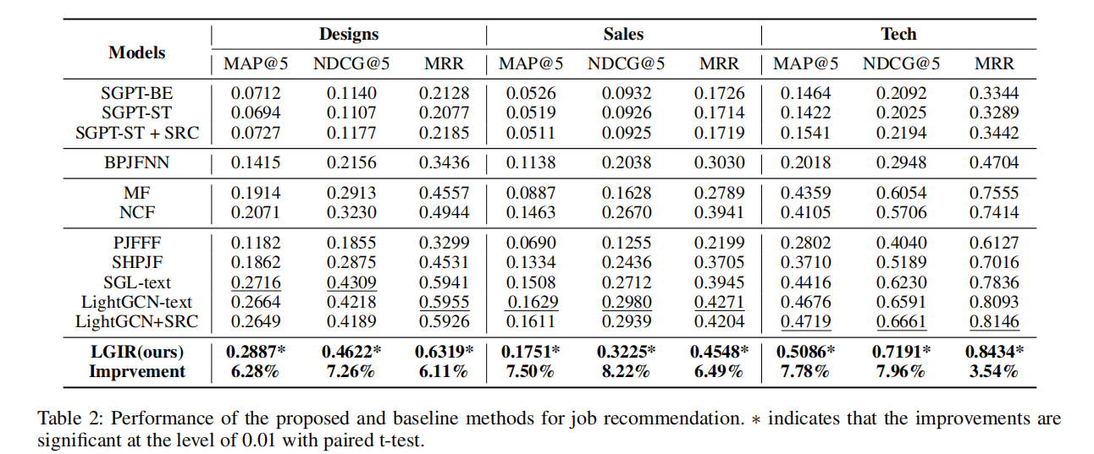
ATAI
AdvancedTechniqueof
Artificial Intelligence
ATAI
ChongqingUniversity _{AdvancedTechniqueof}
of Technology Artificial Intelligence
ChongqingUniversity of Technology
Experiments

Slide 8
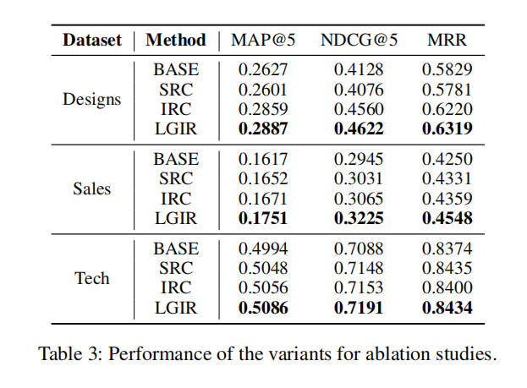
ATAI
AdvancedTechniqueof
Artificial Intelligence
ATAI
ChongqingUniversity _{AdvancedTechniqueof}
of Technology Artificial Intelligence
ChongqingUniversity of Technology
Experiments

Slide 9
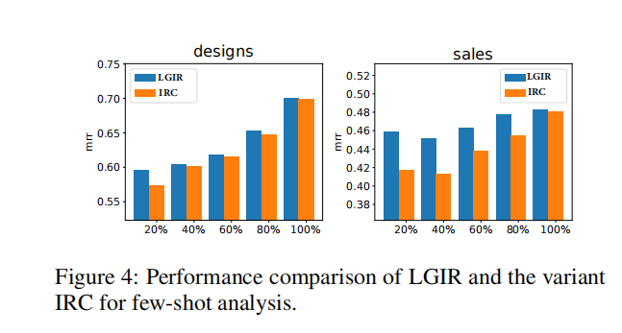
ATAI
AdvancedTechniqueof
Artificial Intelligence
ATAI
ChongqingUniversity _{AdvancedTechniqueof}
of Technology Artificial Intelligence
ChongqingUniversity of Technology
Experiments

Slide 10


ChongqingUniversity of Technology
ATAI
AdvancedTechniqueof
Artificial Intelligence
ATAI
ChongqingUniversity _{AdvancedTechniqueof}
of Technology Artificial Intelligence
Thanks!

